Slide 1





PROBLEMS
2010
2015
2022
125
NOW DAYS THERE ARE VERY FEW PERSONS TO GUIDE US. THERE ARE SOO MANY QUESTIONS WHICH ARE UNSOLVED BECAUSE OF THERE IS NO ONE TO HELP THEM.THATS WHY WE ARE LUNCHING THIS WEBSITE.
100
75
50
25
0
2022 PRESENTATION

Slide 2

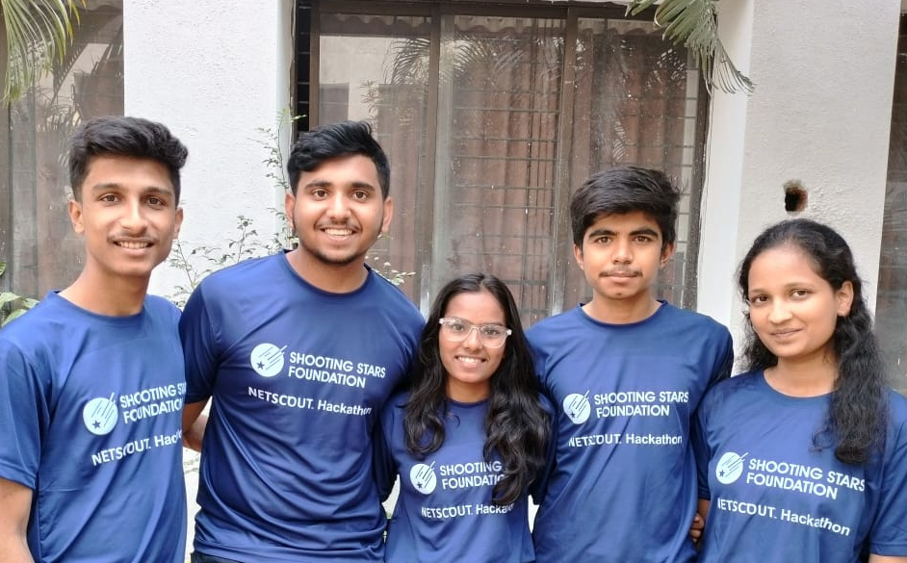
OUR TEAM
Shwet Gugale
Mohanish Kulkarni
Kruthika Janvekar
Shlok Ladkat
Shrilekha Patil
2023 PRESENTATION

Slide 3



PRESENTING
YOUTH HUB

Slide 4

Welcome To Our
Company
Make smart friends, learn from experts, and network like you’ve never done before. It’s a place to have fun and get amazing opportunities!
LEARN MORE

Slide 5

About Us
LET'S COLABORATE TOGETHER AND FORM A KNOWLEDGEABLE COMUNITY.WE WILL TRY,THERE WILL BE NO QUESTIONS REMAINED UNANSWERED.
2023 PRESENTATION

Slide 6


Vision & Mission
01
About Vision
to build the biggest website\app in the World for resolving any technical type of problems
02
About Mission
to become global website and reach out to 10 lakhs + people. to give the best solution to there problems
2023 PRESENTATION

Slide 7
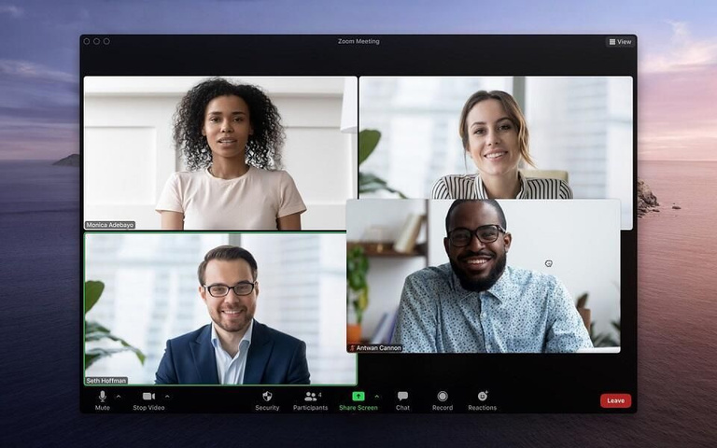
Our Website About
Technology
Website
we are going to use AI genrated website which can give probably the accurate solution for the question but, if it will not provide answer we have an option to connect with the mentor .
LEARN MORE
2023 PRESENTATION

Slide 8




Company Contact
7385281738
youthhub.05@gmail.com
https://bluebarry.mohanishkulkarni.repl.co
2023 PRESENTATION

Slide 9




Slide 10

THANK YOU
2023 PRESENTATION

